Slide 1

MGT 5220 Final Project
Yinan Guo, Jingjing Li, Yilin Qian

Slide 2

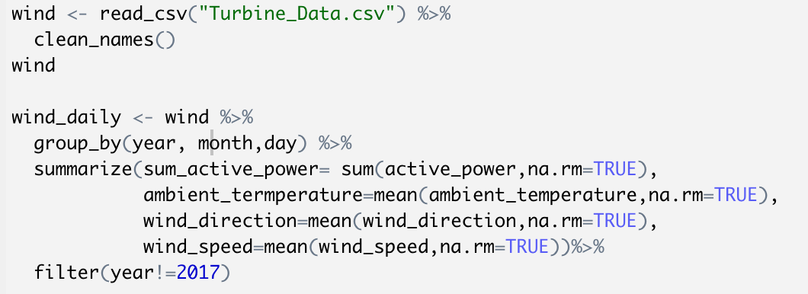
Data Preparation
Import Data and Summarize Data
Group by date
Replace missing value with average value
Strip out data in 2017.12.31
3

Slide 3
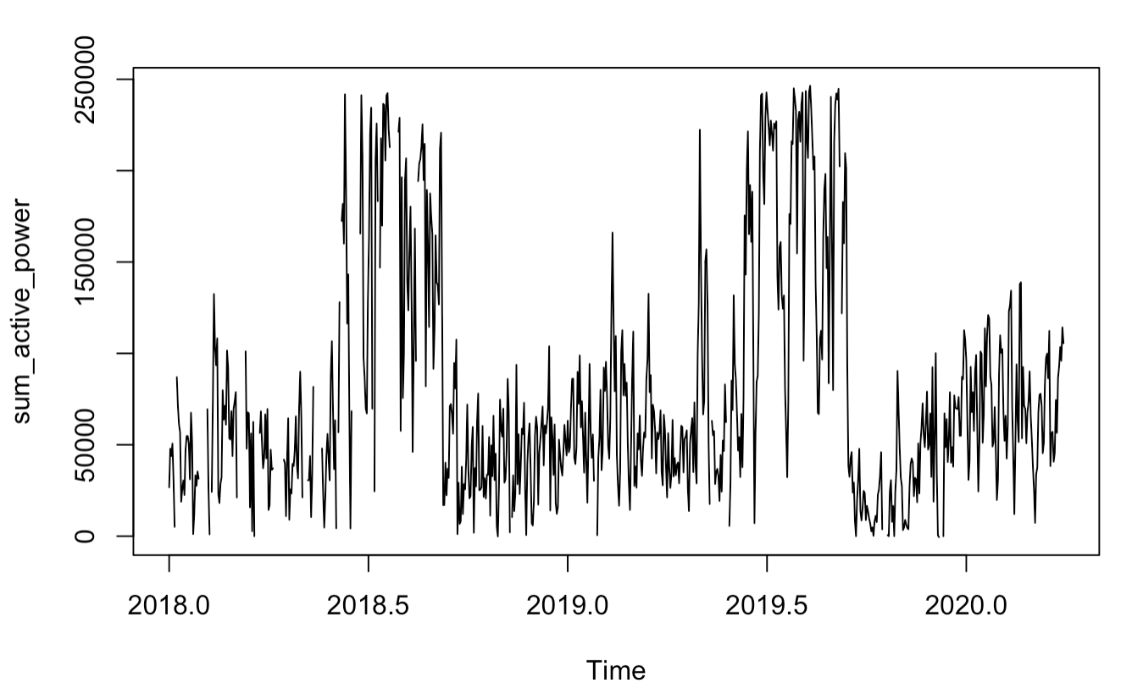
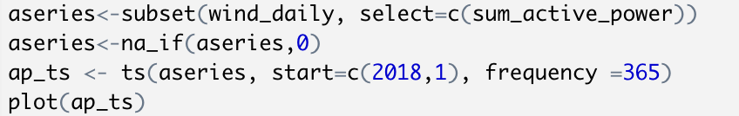
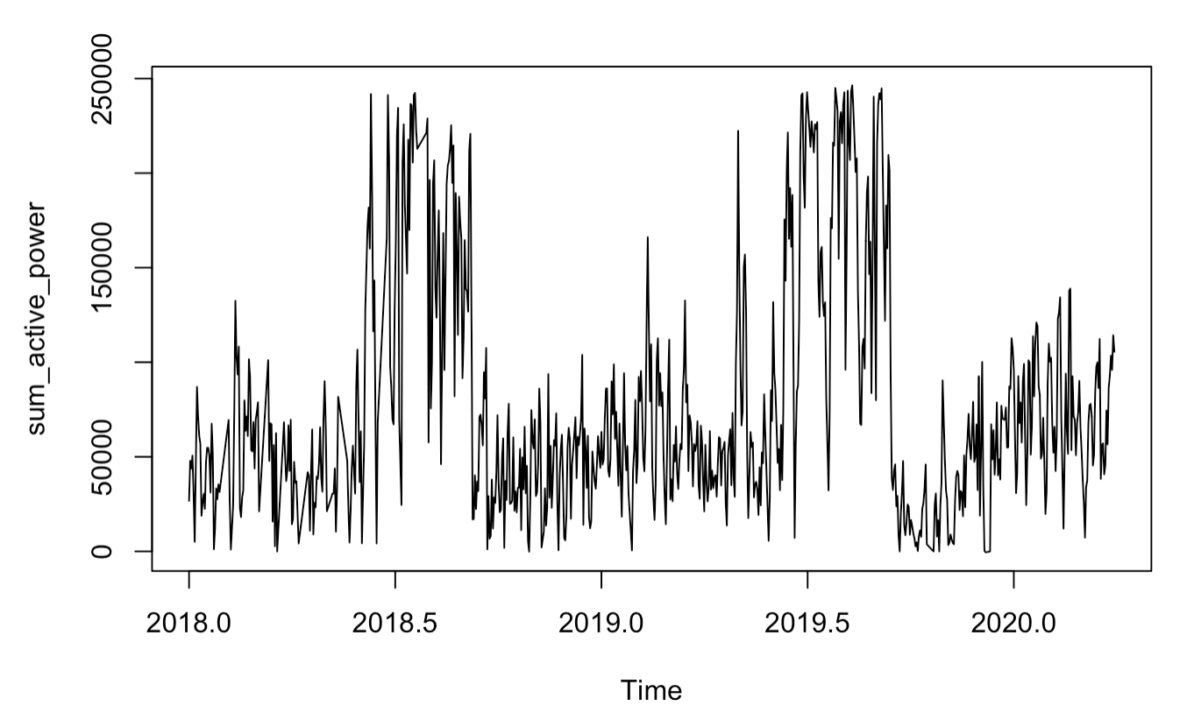
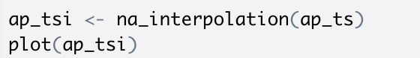
Data Preparation
2. Create a time series object
Use interpolation to fill missing value
3

Slide 4
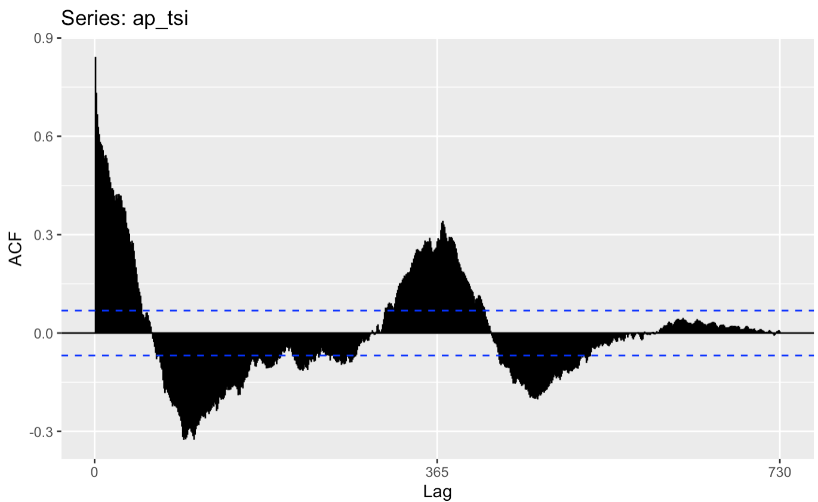
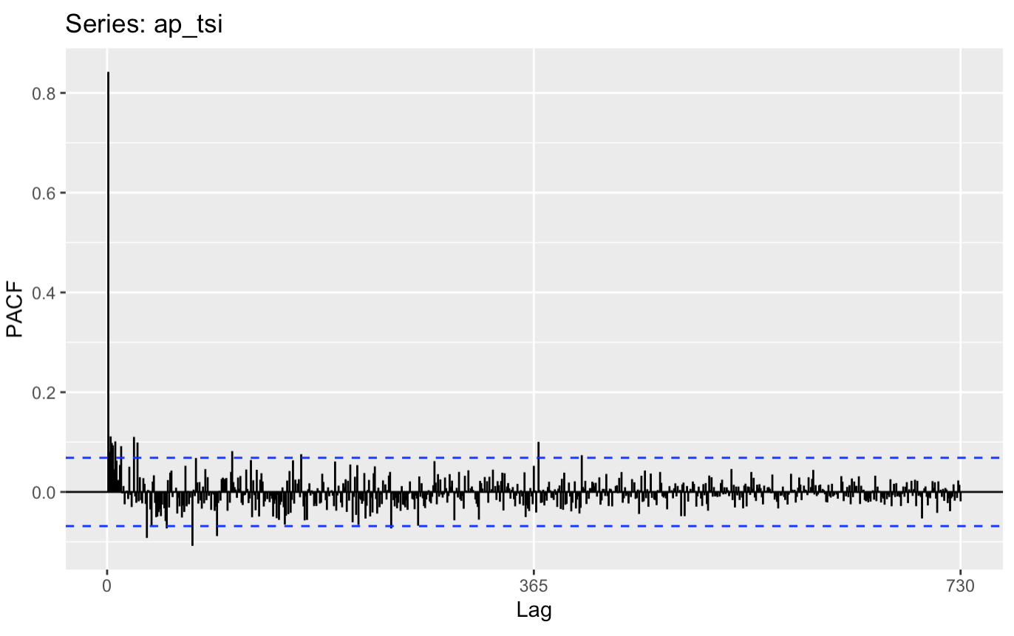
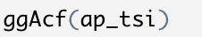
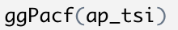
Data Preparation
3. ACF and PACF Plot
3

Slide 5
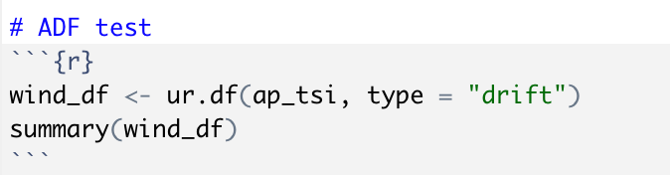
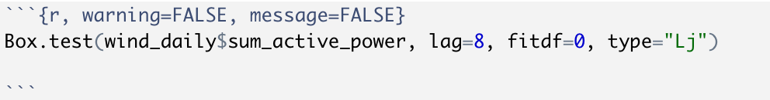
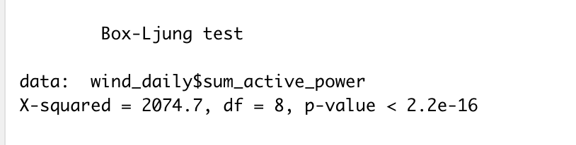
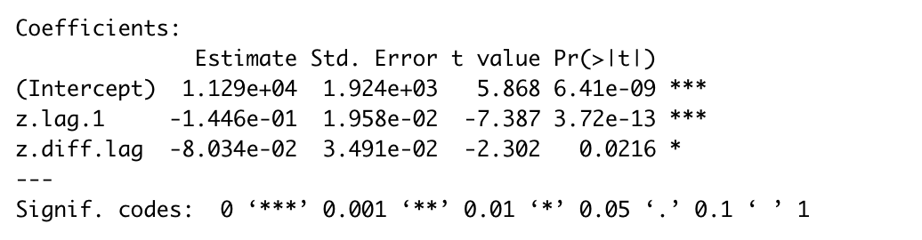
Data Preparation
4. Not White Noise & Is Stationary
3

Slide 6
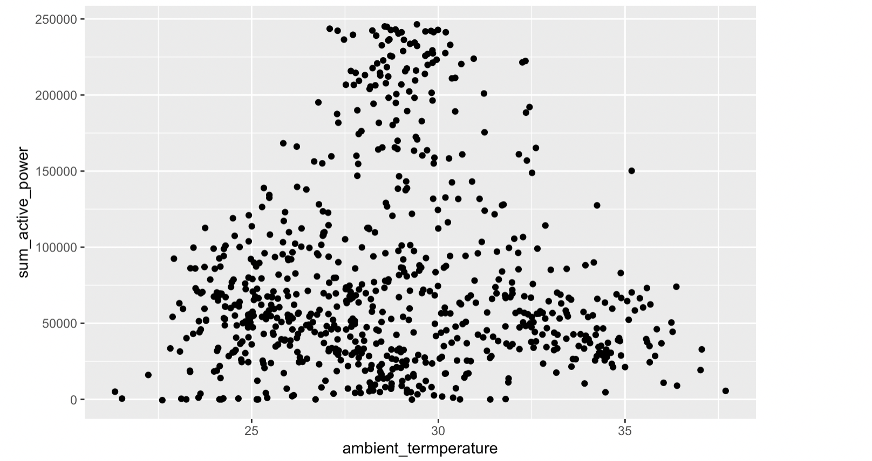
Visual summary of the data
Ambient Temperature
3

Slide 7
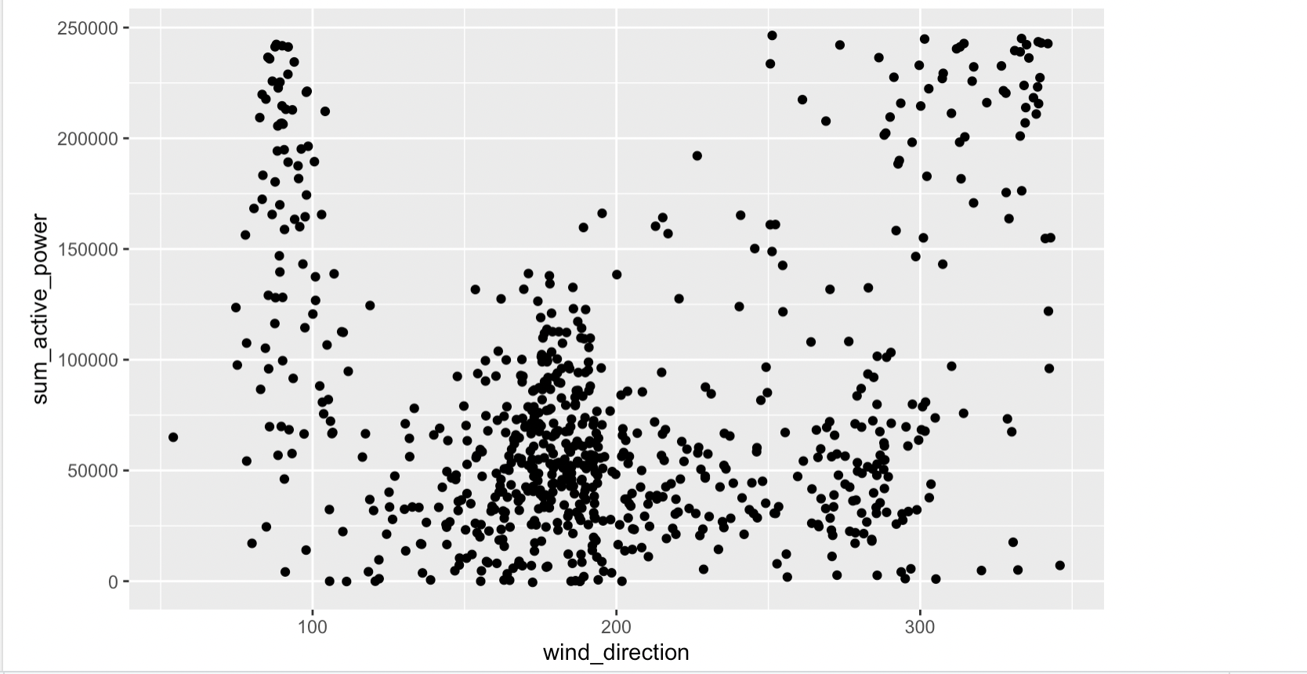
Visual summary of the data
Wind Direction
3

Slide 8
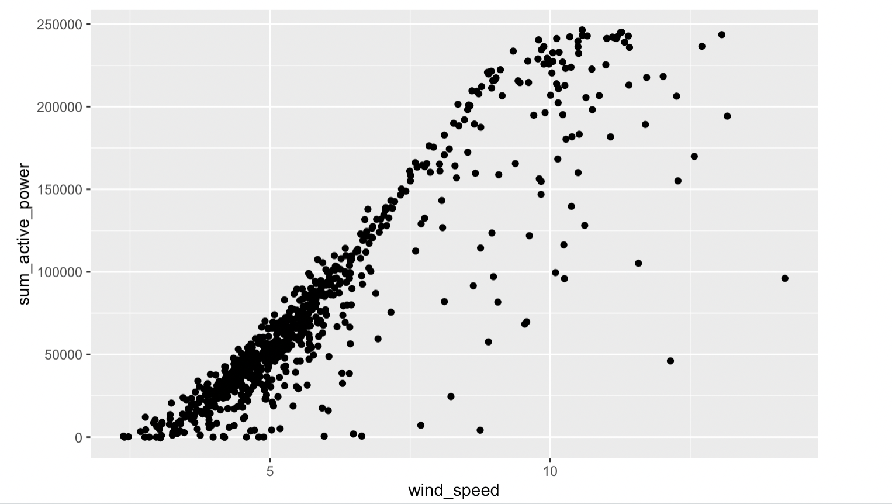
Visual summary of the data
Wind Speed
3

Slide 9
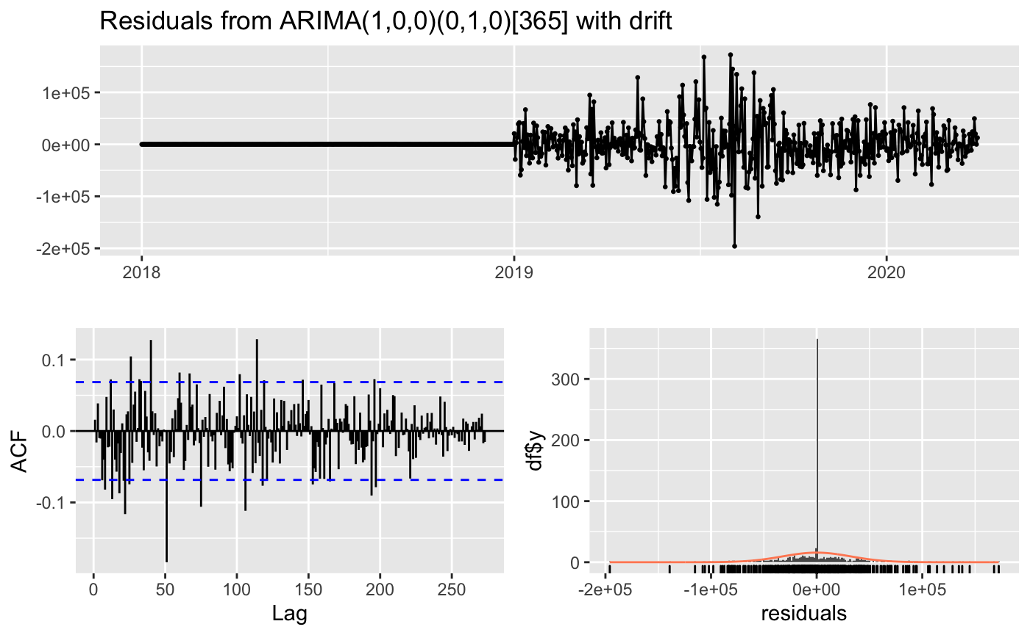
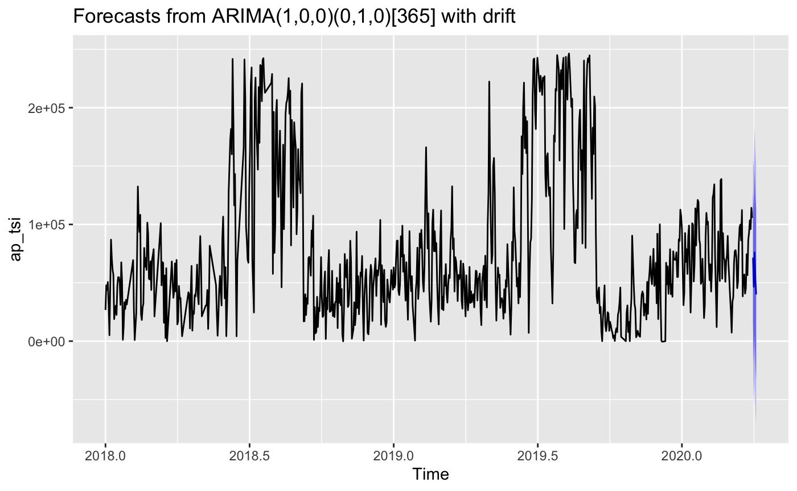
Modeling Process
Auto Arima without intervention
Seasonality
Residuals not white noise
3

Slide 10
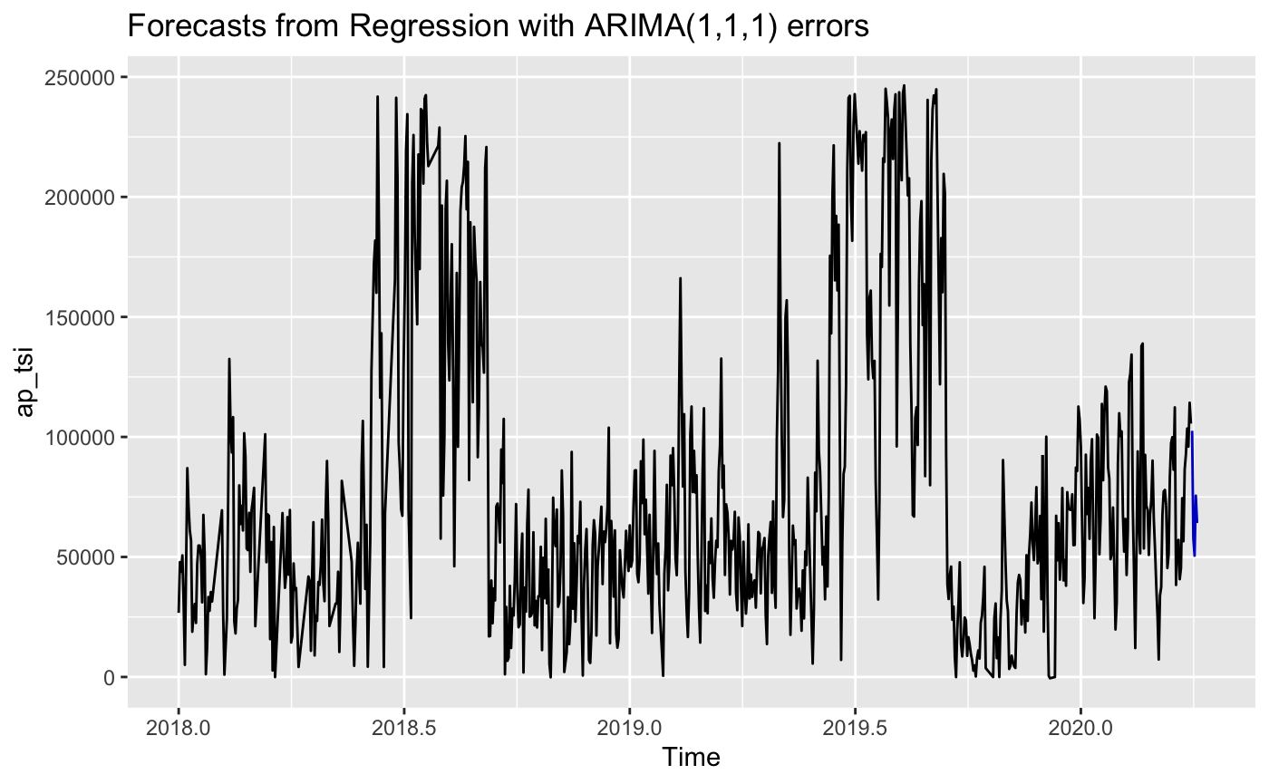
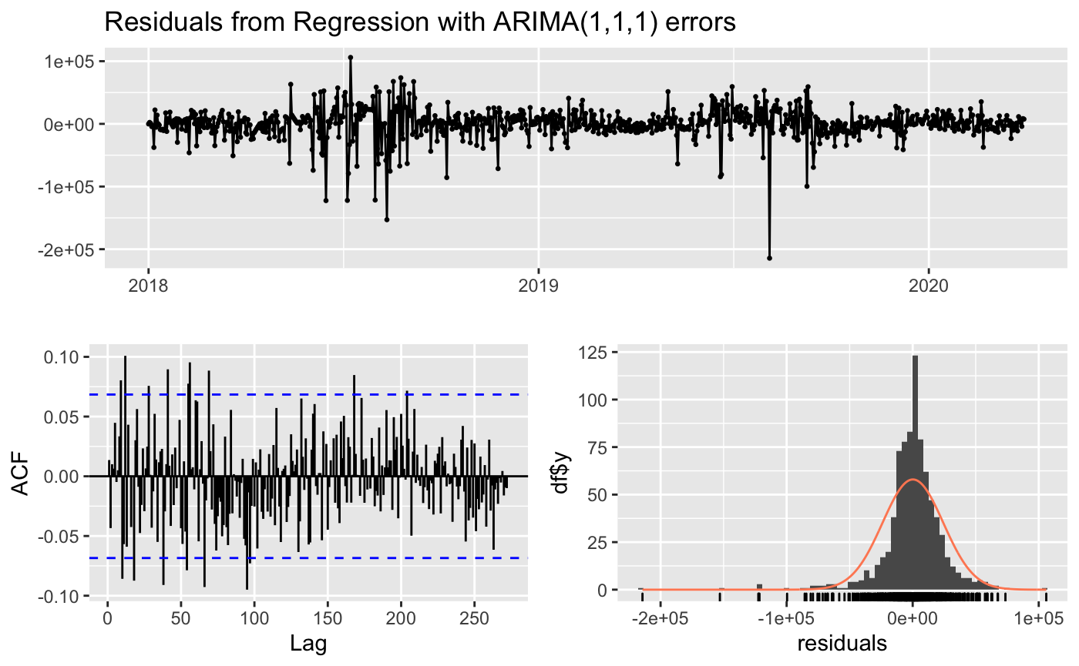
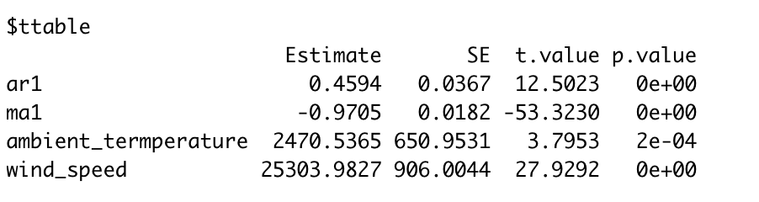
Modeling Process
2. Auto Arima with intervention
No Seasonality term
Residuals not white noise
All predicting terms are significant
3

Slide 11
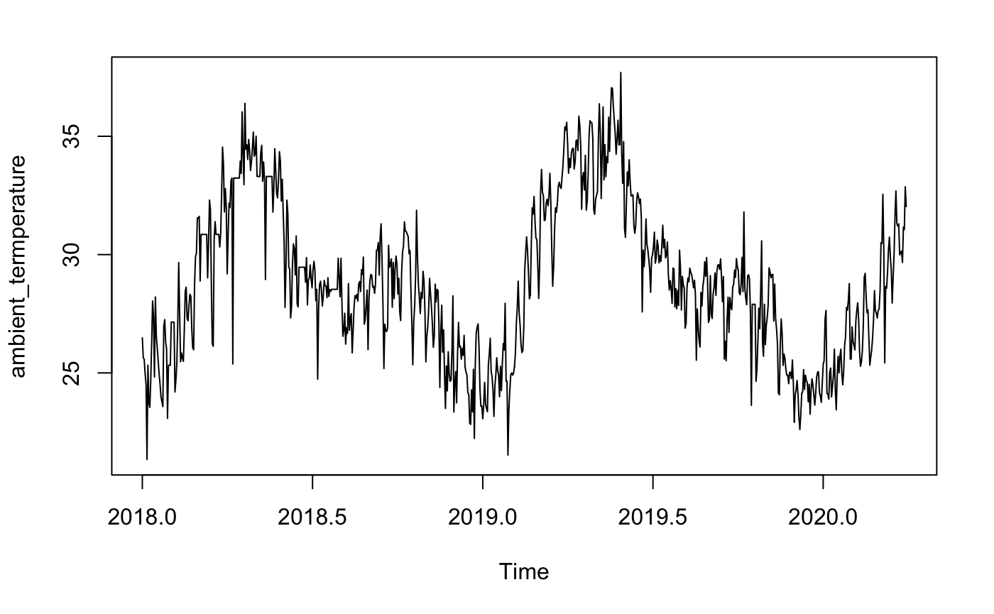
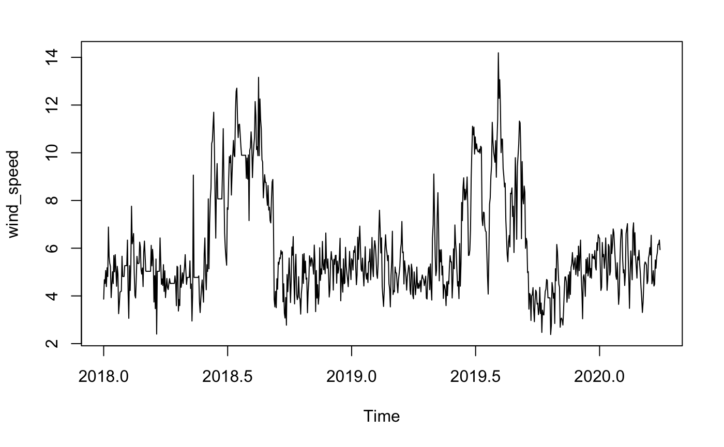
Modeling Process
Ambient Temperature
Wind Speed
X has seasonality
3
Notes:
One of our guessing is that , we can see from these two time series plot, there are seasonality pattern in ambient temperature and wind speed
When we consider using x in our model, we already use their seasonality, so we can consider not using both X and seasonality term in our model

Slide 12
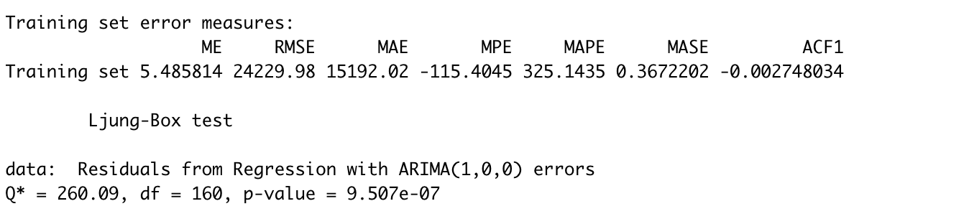
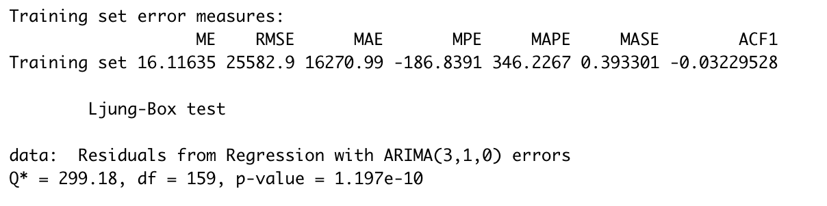
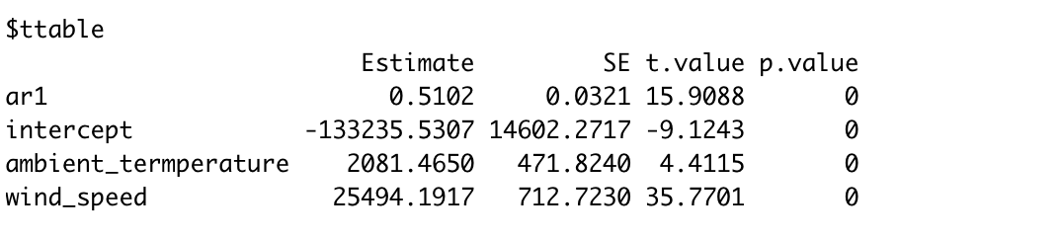
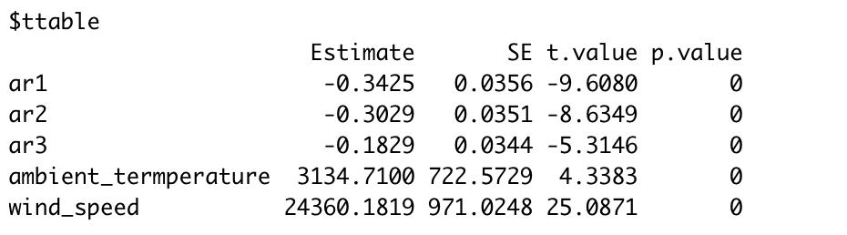
Modeling Process
3. Arima Models with intervention & without seasonality
From Arima(1,0,0) to Arima(3,1,0)
Residuals not white noise
All predicting terms are significant
Similar RMSE and MAPE
3

Slide 13
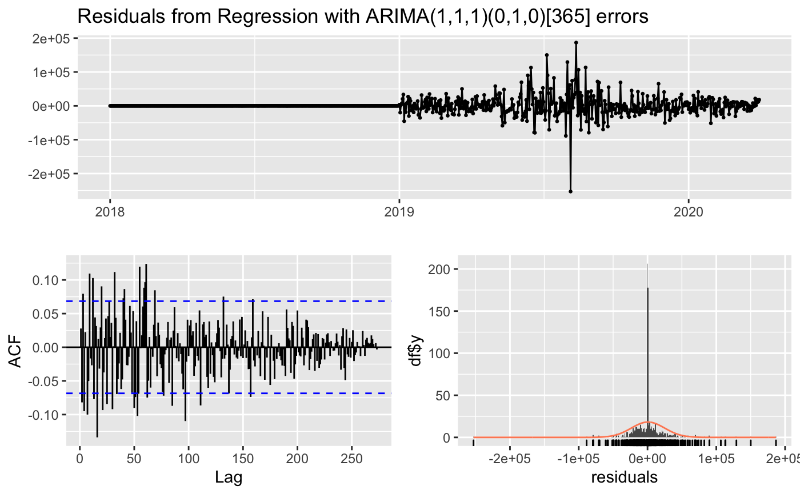
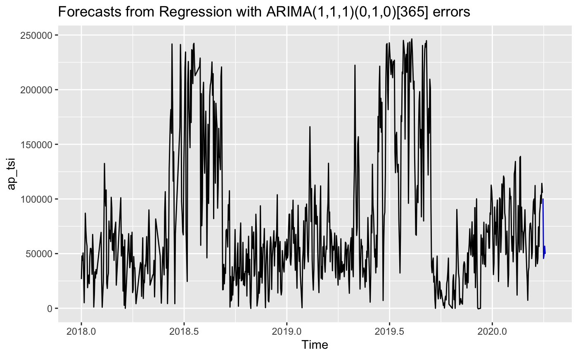
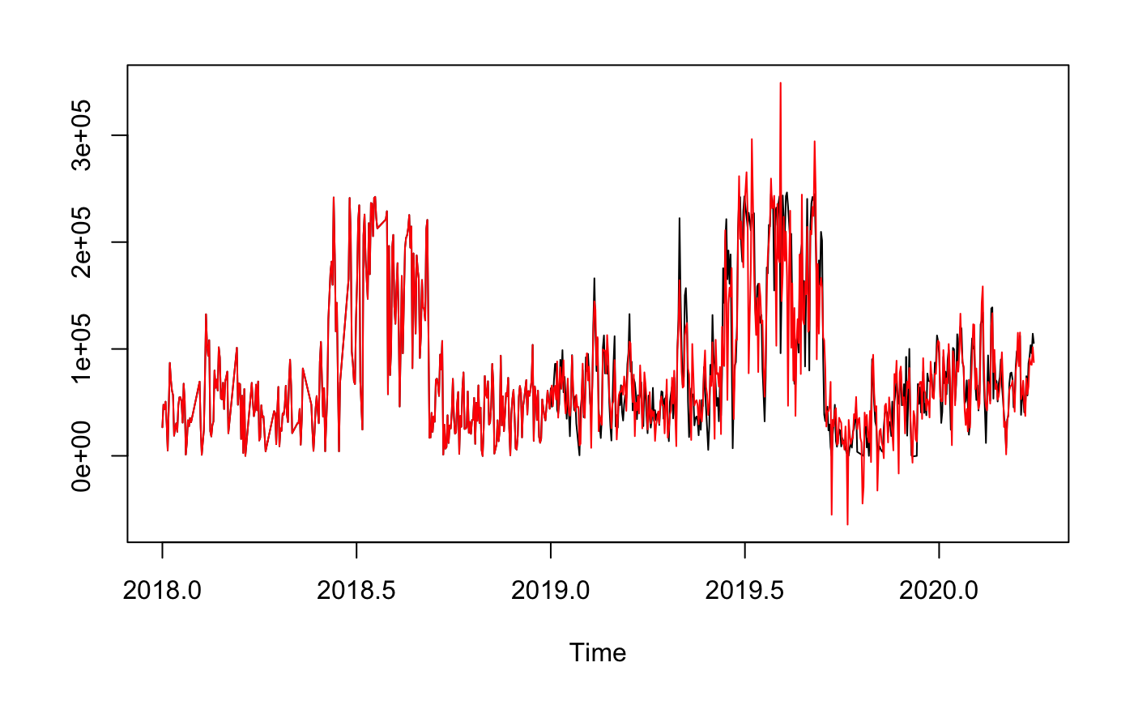
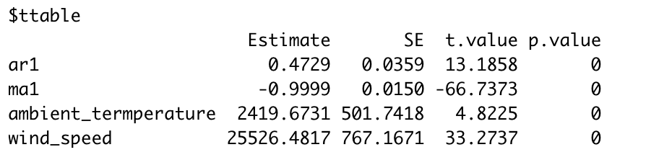
Modeling Process
4. Arima(1,1,1)(0,1,0)[365] with intervention and seasonality
Residuals not white noise
All predicting terms are significant
3

Slide 14
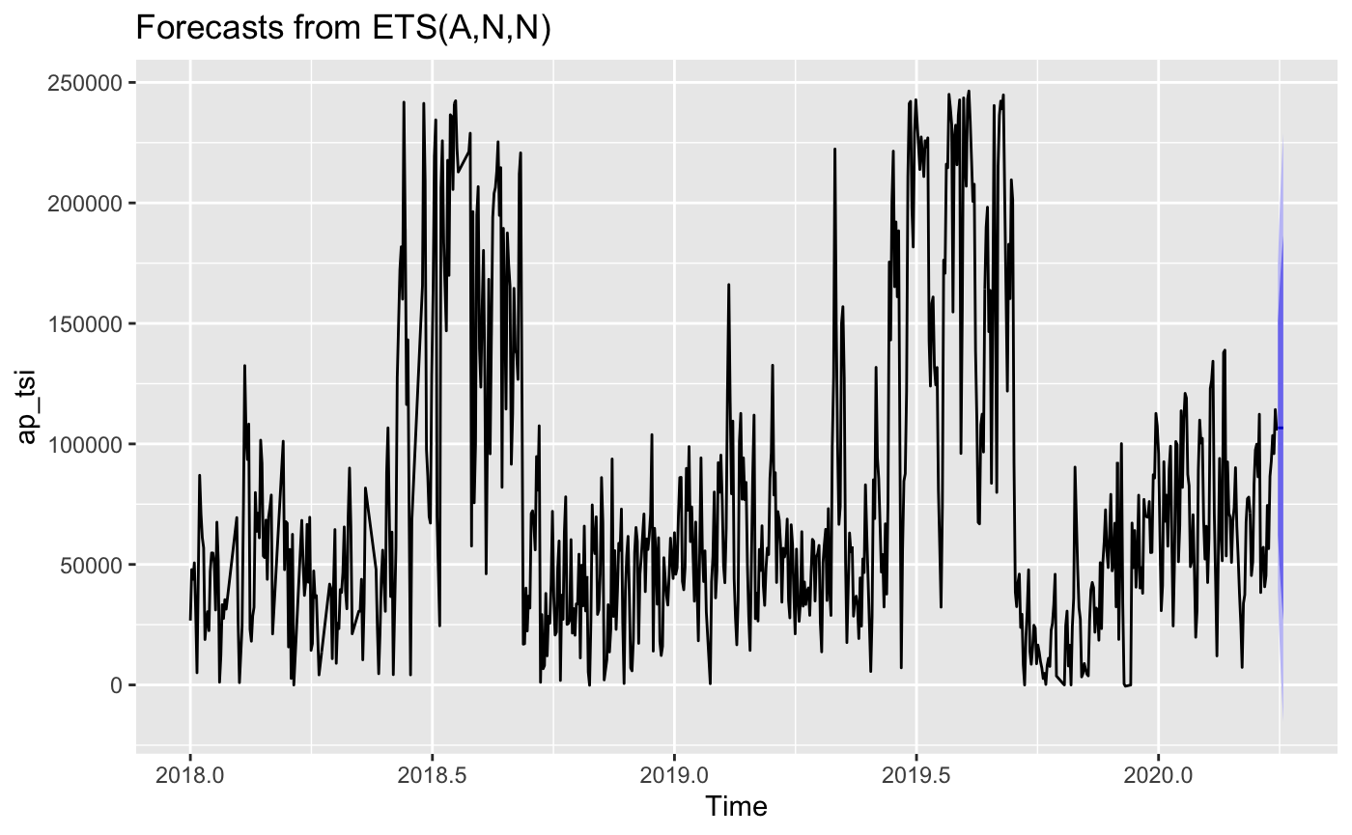
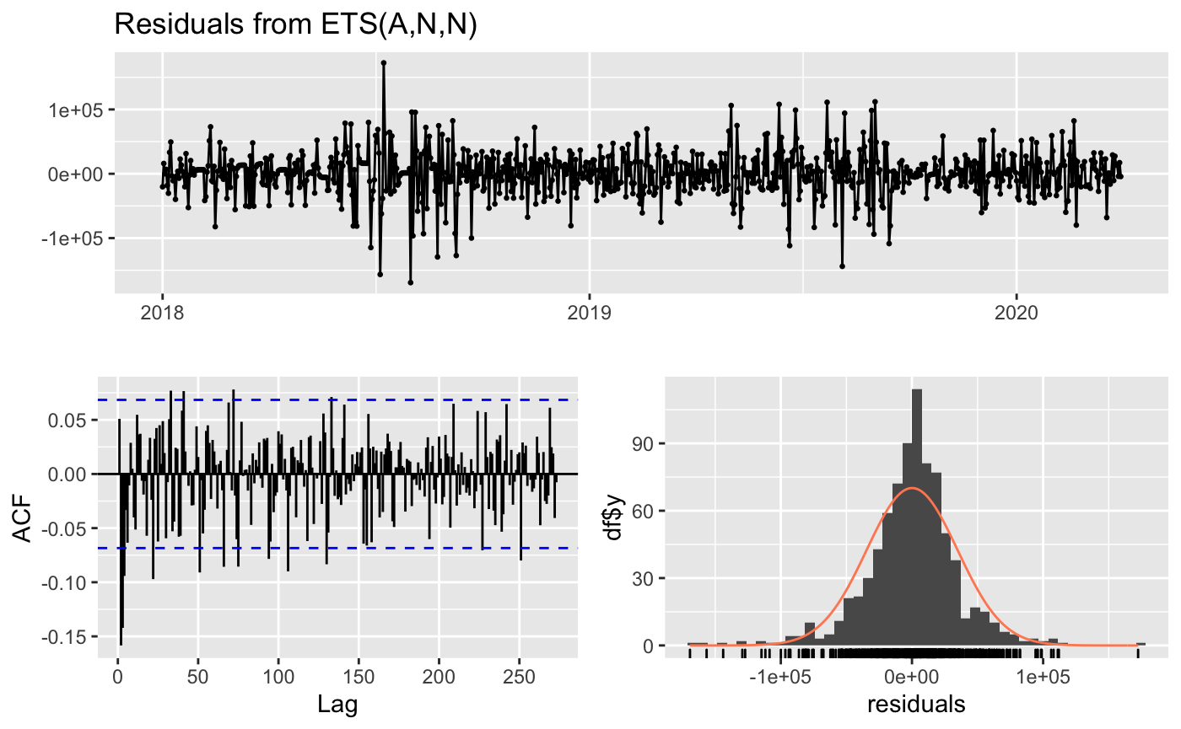
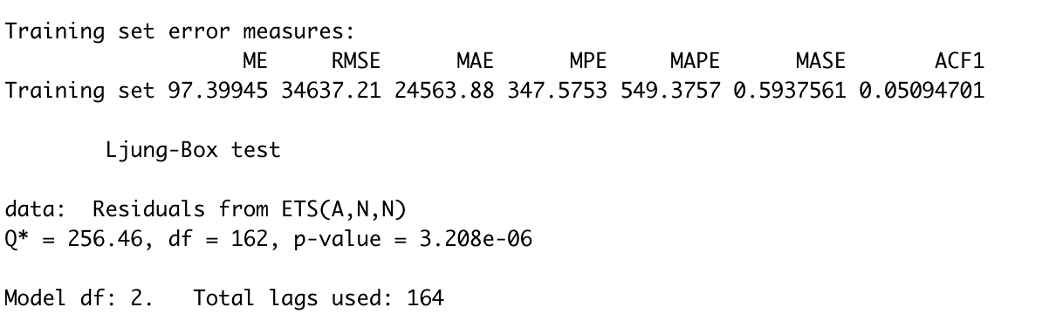
Modeling Process
5. Exponential Smoothing - Holt Winter
Residuals not white noise
3

Slide 15
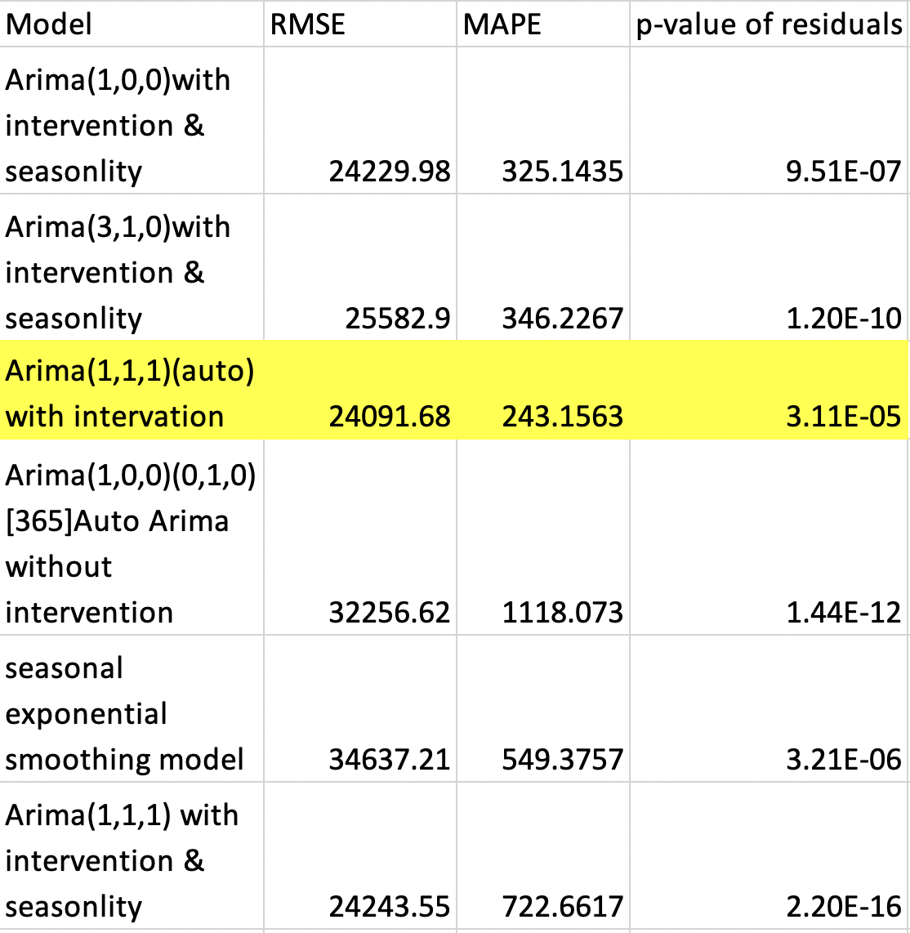
Final Model-Auto Arima(1,1,1)with intervention
Model Comparation
3

Slide 16
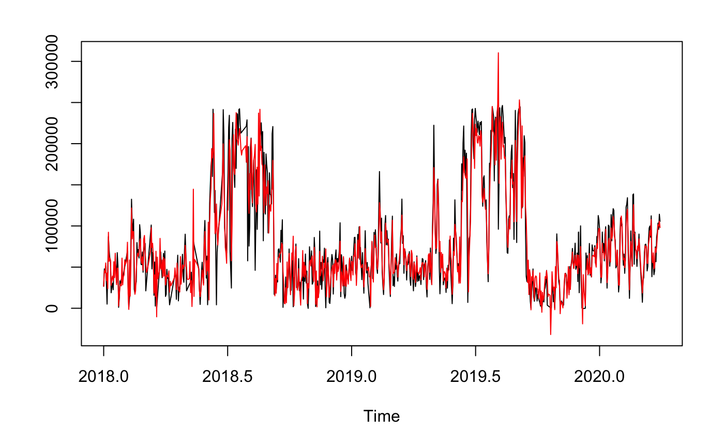
Final Model-Auto Arima(1,1,1)with intervention
Forecast vs Actual
3

Slide 17
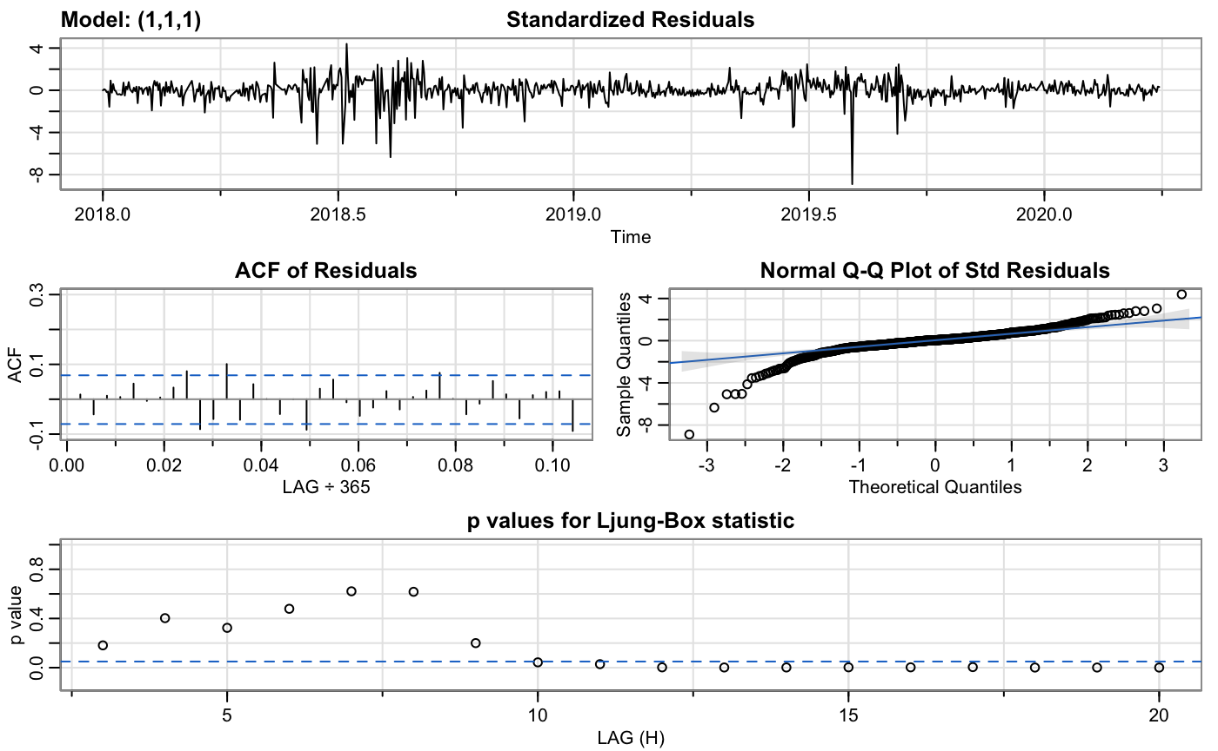
Final Model-Auto Arima(1,1,1)with intervention
3
Notes:
Although not all p-value of residuals are over 0.05, most of them marginally over or close to 0.05

Slide 18
Final Model-Auto Arima(1,1,1)with intervention
3

Slide 19
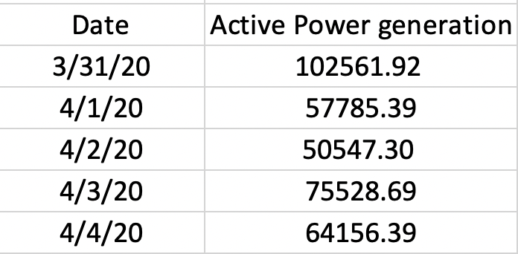
Final Model-Auto Arima(1,1,1)with intervention
Forcast
3

